Slide 1
B²-Coupon: Efficient and Non-intrusive Mobile
Coupon Distribution using Dual Bloom Filter
Xueda Shen
Dept. of Maths.
University of Illinois at Urbana Champaign
Jiyu Hu
Dept of Elec. and Comp. Engr.
University of Illinois at Urbana Champaign
Yunqi Zhang and Ian C. Quinn
Dept. of Comp. Sci. and Engr.
The Ohio State University
Notes:
Title of project
Team intros (name & insititution)

Slide 2
Table of Contents
Introduction
System Design
Evaluation
Discussion & Conclusion
Notes:
The contents of this presentation is as follows:
1. 2. 3. 4.

Slide 3
Introduction - backgrounds
Coupons are widely used to boost sales
For Ecommerce owners, interest matching is extensively used to increase potential usage of the distributed coupons.
For P2P systems, such mechanism is not present.
Traditional P2P coupon forwarding is also intrusive, annoying the user and further decreasing the odds of using the forwarded coupon.
Notes:
Introduction current background: e coupons are used widely nowadays.
Merchants interest matching for increase use of coupons
But p2p systems does not have this implementation
Also traditional p2p intrusive (i.e. need mannual connection setup for forwarding and recieving coupons)
Thus annoy users

Slide 4
Introduction - related works
P³-Coupon:
A probabilistic one ownership model.
Only one forwarder is recorded according to preset probability for reward
Use Bluetooth Service Discovery Protocol for data transmission without manual connection setup
Reward distribution is not fair when forwarded coupon number is small
Notes:
P3 Coupon is a probabilistic one ownership model
(explain: one ownership is only one forwarder is recorded for coupon reward
This is privacy preserving: only own forwarder is recorded
Space efficient: forwarder recording does not take much space for transfer
Each forwarder has a preset probability to be assign as the owner. Achieve fair reward distribution when forwarded coupon number is big)
Drawbacks:
Distribution not fair when # of coupons is small
No interest matching algo. The coupon might take a lot hops to propagate to target users

Slide 5
Introduction - Contributions of B²-Coupon
Design the Dual Bloom Filter for:
Efficient Coupon propagation
Fair Reward Distribution
Construct a communication layer based on Bluetooth Low Energy beacon with no manual connection setup
Conduct extensive simulation and implementation-based evaluation
Notes:
This leads to our B2 Coupon:
We use Dual bf for a. B.
We also use BLE. this enables seameless data transfer between users (i.e. no manual connection setup between devices is necessary)
Simulation & implementation based evaluation are conducted to verify the functionality of B2 Coupon

Slide 6
System Design - the Bloom filter
The Bloom filter: a probabilistic data structure for checking whether an element is in a set.
[1]
False Positive Rate:
Optimal Number of Hash Functions:
[1]: https://www.abhishek-tiwari.com/bloom-filters-is-element-x-in-set-s/
Notes:
First introduce the features of bloom filter:
Bloom filter is a prob…
Bt main data structure is simply a bit array (array with 1s and 0s)
There are mainly 2 operations one can do to a bf: add an element, check if that elem is in the bf
add:
Element is hashed with k hash functions (k can be determined, introduced below)
The entry of hashed result is set to 1.
E,g, x is passed through 3 hash functions: for 3 hash values: 1, 6, 14. These entries in the bf is set to 1
check:
Hash the checking item w the same hash functions
Check if all corresponding entries are 1
If yes, the bf claims that the item is in, otherwise not.
E.g. we want check if item y is in the bf, we can know y is hashed to 6, 17, 22.
All entry is 1, so y is in the bf
On the other hand, w is has one hased entry 30, which has 0, so bf claims w not inside.
This lead to the false positive of bf: e.g. if another item f is hashed to 6, 11, 22. In the above bf, even f has never been added, we can see that all these entris are 1s, suggesting it is in the bf
False negative can never happen because: once the item is added, all hashed entries must have been set to 1. Bf never set a 1 entry back to 0. So it never happens that later you this elem, it is hashed to a 0 entry.
The formula for calculating fp is as follows
The variable in the formula: m: bf size (in bits), n: expected number of items we wanna put in the bf, k: number of hash functions
There is also a formula for optimal number of hash functions

Slide 7
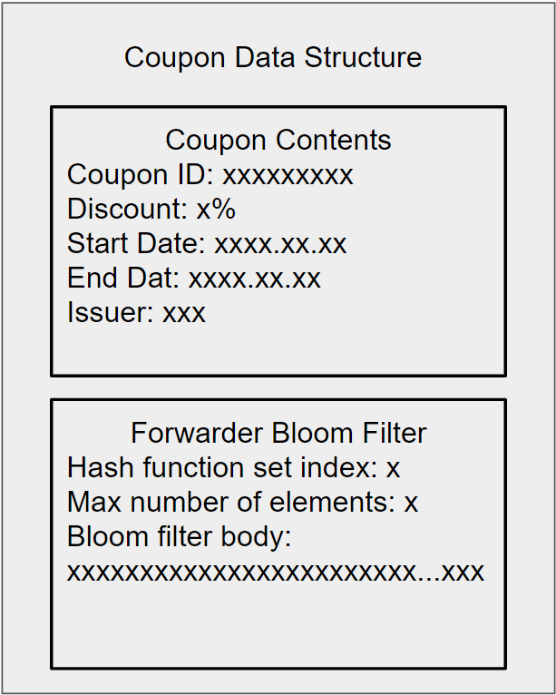
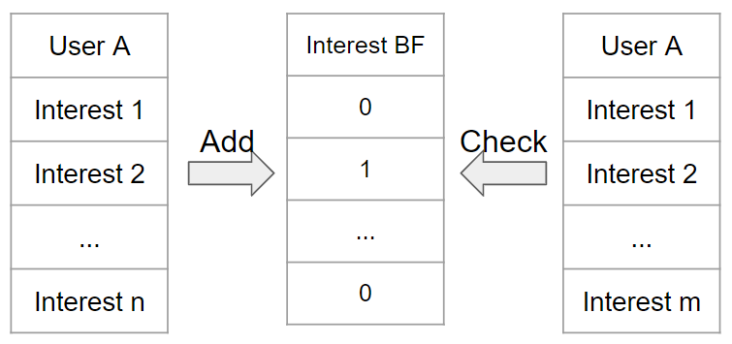
System Design - the Dual Bloom Filter
Interest Bloom Filter
Forwarder Bloom Filter
Compare Interest Matching I to a preset threshold T
Notes:
We use two bf:
Interest bf for interest matching:
Explain how it works
Each user has one
(add on: explain this is generated from user’s interests, ask the user to specify its area of interest during registration process)
Forwarder bf:
This comes along with each coupon
Keep track of forwarder chian (detailed explanation later)

Slide 8
System Design - system architecture
Main Server: Store User ID and User Info, calculate reward assignment
Store Side Server: Generate and distribute coupons, distribute reward
User: Distribute and redeem coupons
Redeem Coupon
Main Server
Redeem Coupon
User ID
User Info
Reward Info
User
User
User ID
User Info
Reward Info
Store Side Server
Store Side Server
Coupon
Coupon
Store Side Server
User
User
Coupon
Coupon
Reward
User
User
Notes:
We have mainly 3 types of components in a B2 coupon system: main server store side server, User
Main server keeps all user info
Store side server generate coupons, distribute coupons and rewards to users

Slide 9
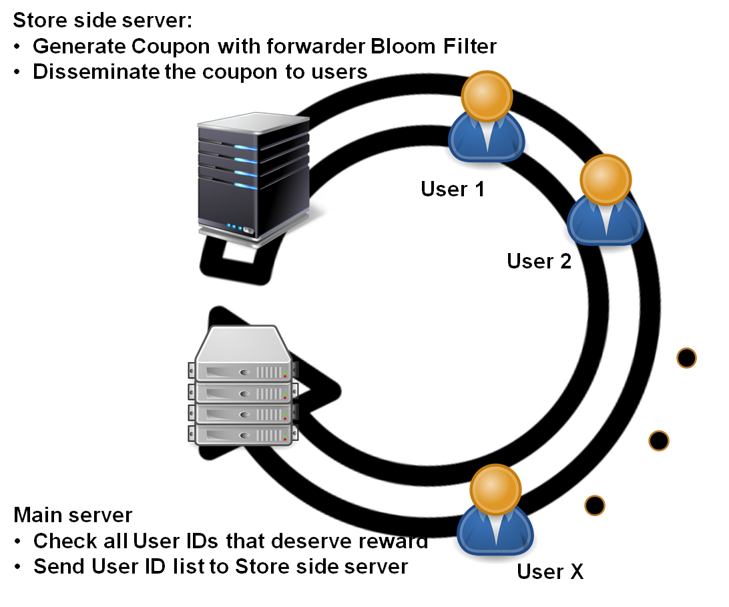
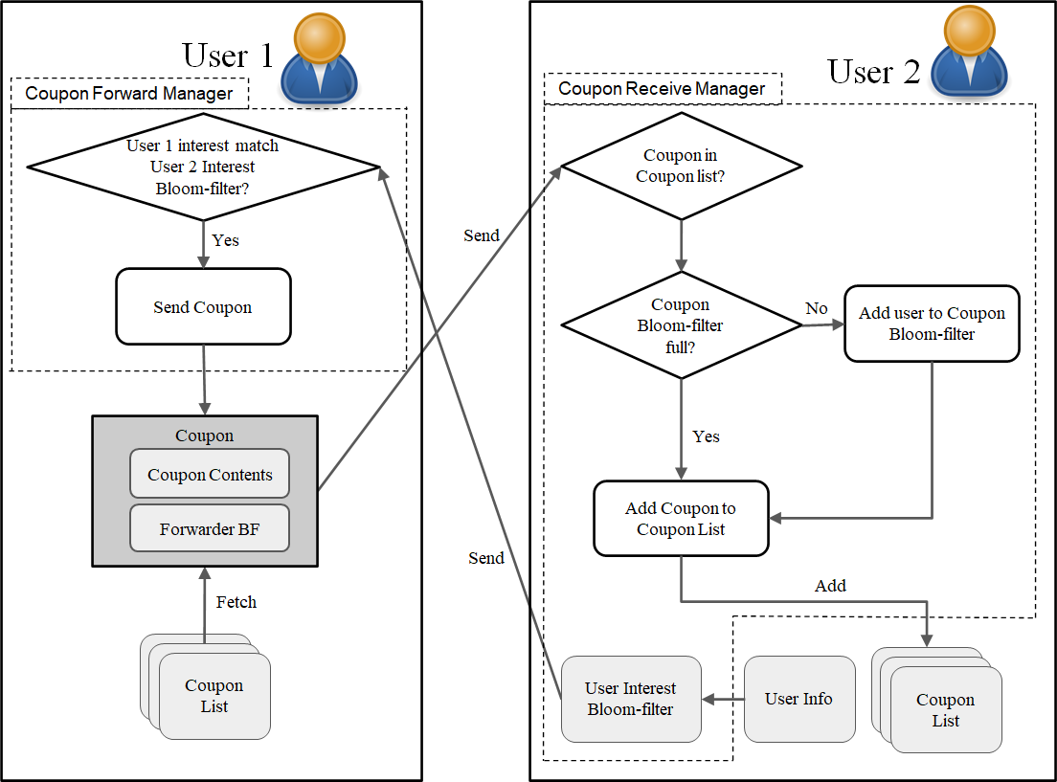
System Design - workflow
Notes:
Entire workflow begin with store side server:
It generates coupons: coupon contents, also the forwarder bf
Sends to users
Finally one user redeem to coupon, coupon back to main server
Main server checks all user IDs against the forwarder bf to get forwarder chains
It tell this to store side server so that sds can distribute the rewards to users
One the right illustrates the process of coupon forwarding between two users:
User 2 keeps broadcasting its interest bf
User 1, upon reception of the interest bf, check it against its own interests (explained earlier)
Before sending, add ID to forwarder bf of the coupon Sends to coupon if matching above T(threshold)

Slide 10
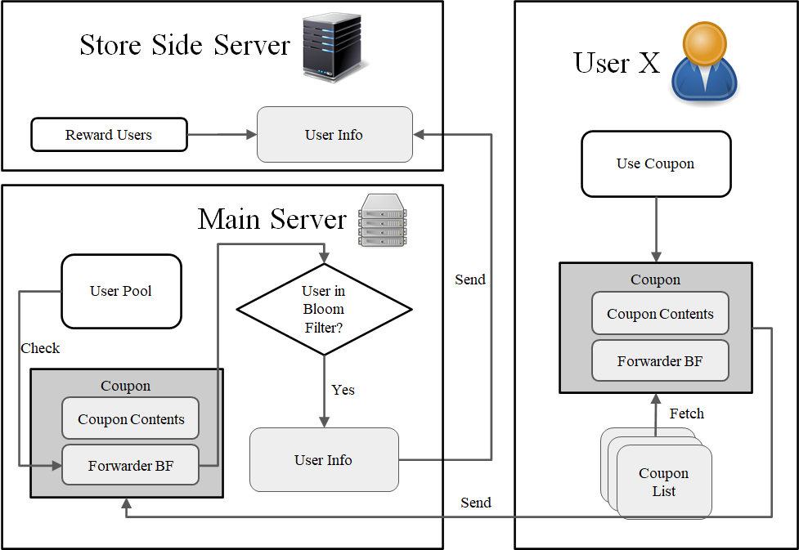
System Design - workflow
Notes:
This shows coupon redeem process. When a coupon is used, it is sent to the main server
The main server then retrieves the forwarder BF can check all user ID, see if it present in the bf
Tell the store side server to distribute rewards to those forwarders
Fp can happen: some users who have not participated in forwarding exist in the forwarder bf, thus receiving the reward
But this can be controlled by bf parameters setup.

Slide 11
Evaluation - simulation based
We need to focus on two aspects of our method. 1. Efficiency. 2. Fairness.
Efficiency means that given a population of interest, how fast can we send the coupon to the entire population?
Profits are generated within the forwarding process. How do fairly allocate such profits?

Slide 12
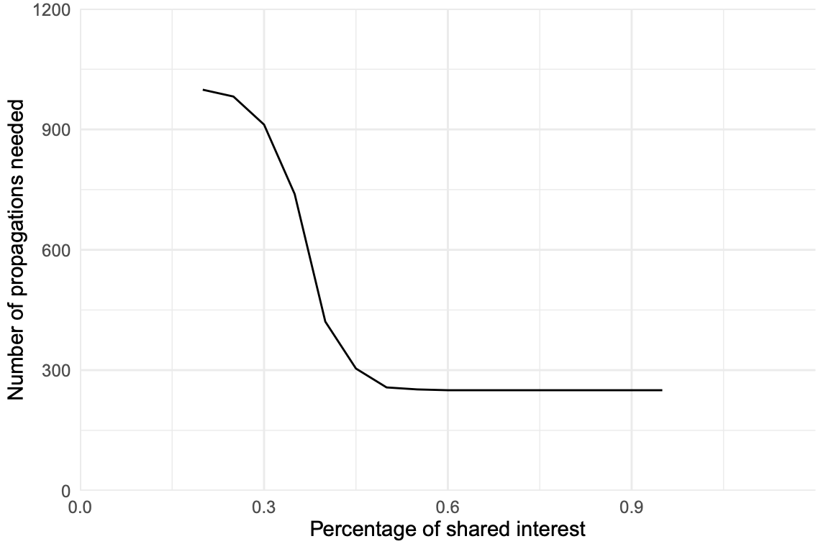
Evaluation, efficiency.
This figure serves as an ‘ablation study’ on the existence of our interest matching mechanism.
In the same figure, we are able to explore the difference when we included the module, and the number of hops needed to traverse the population of interest when the threshold is higher.

Slide 13
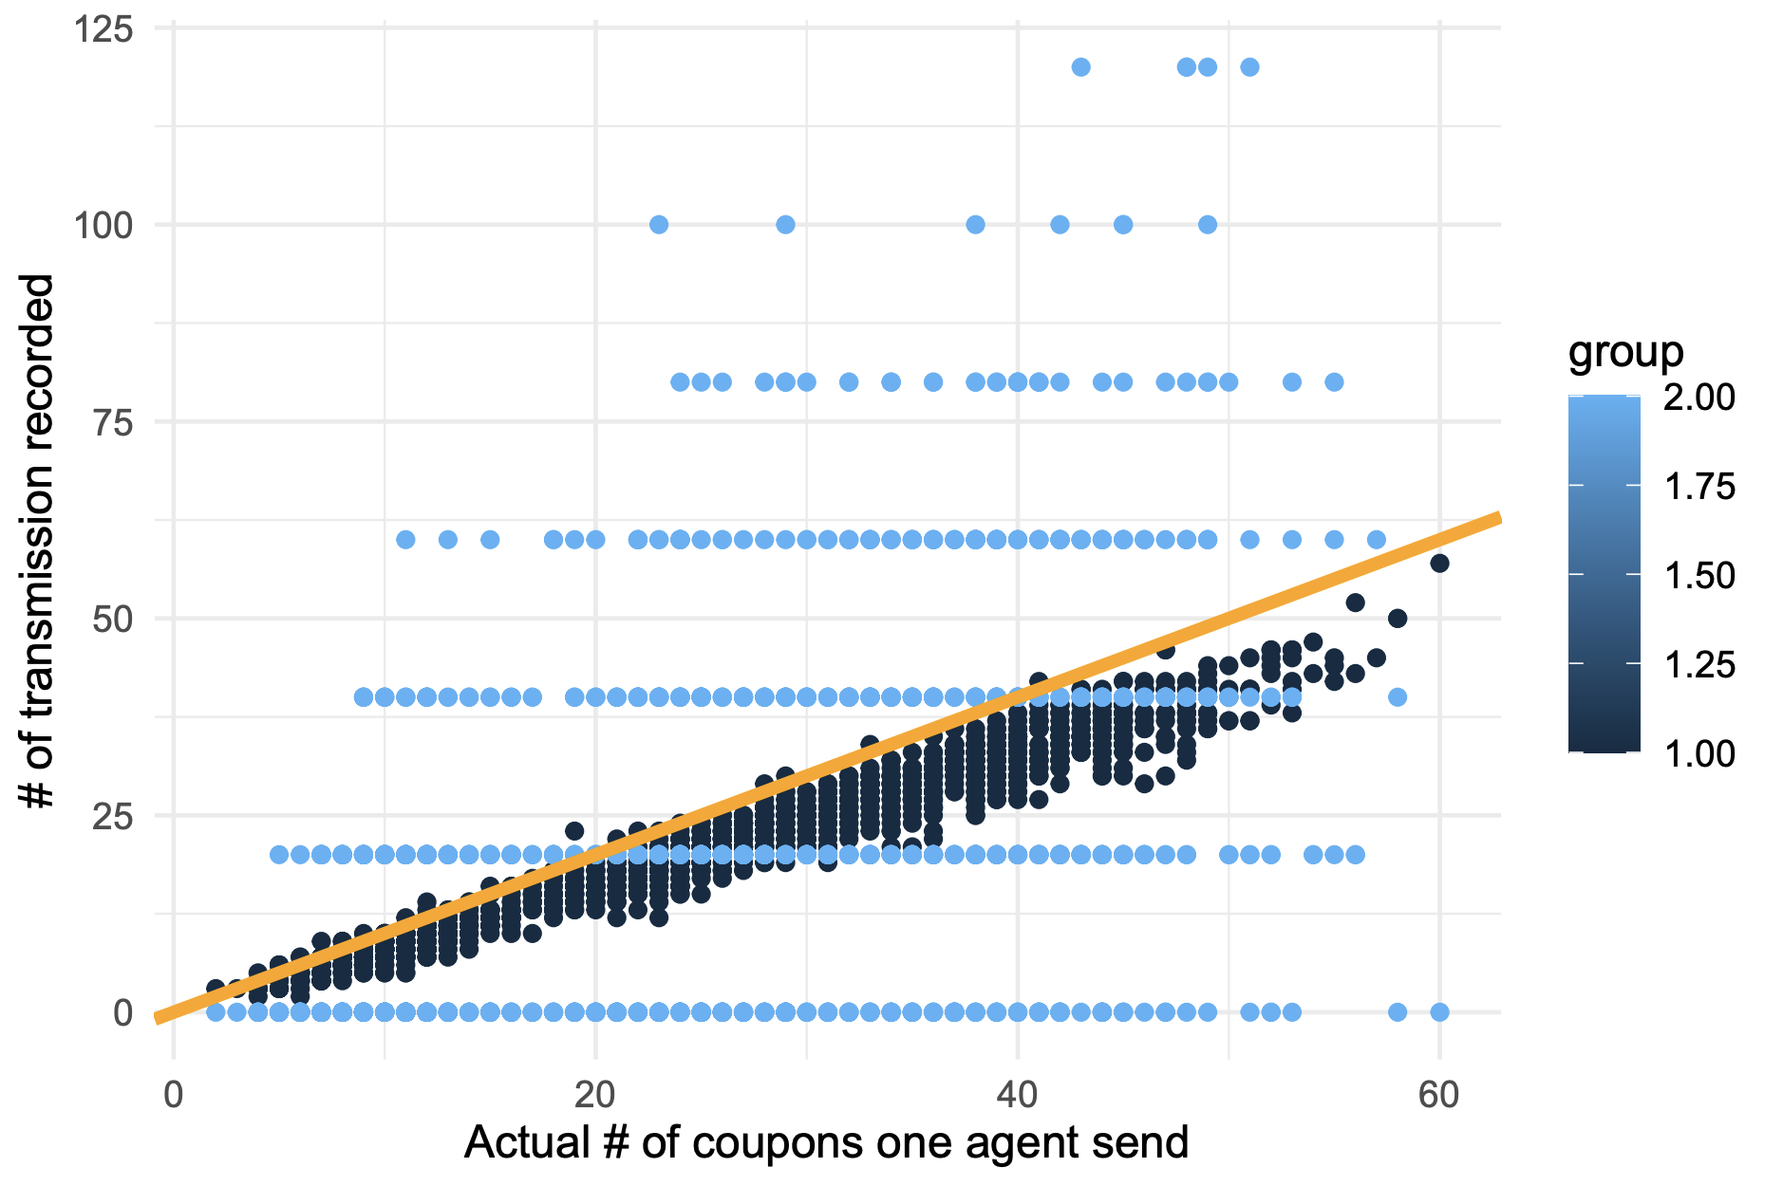
Evaluation, fairness
Profit assignments are based on ownership assignments.
Other methods may not be able to truly register the ownership accordingly.

Slide 14
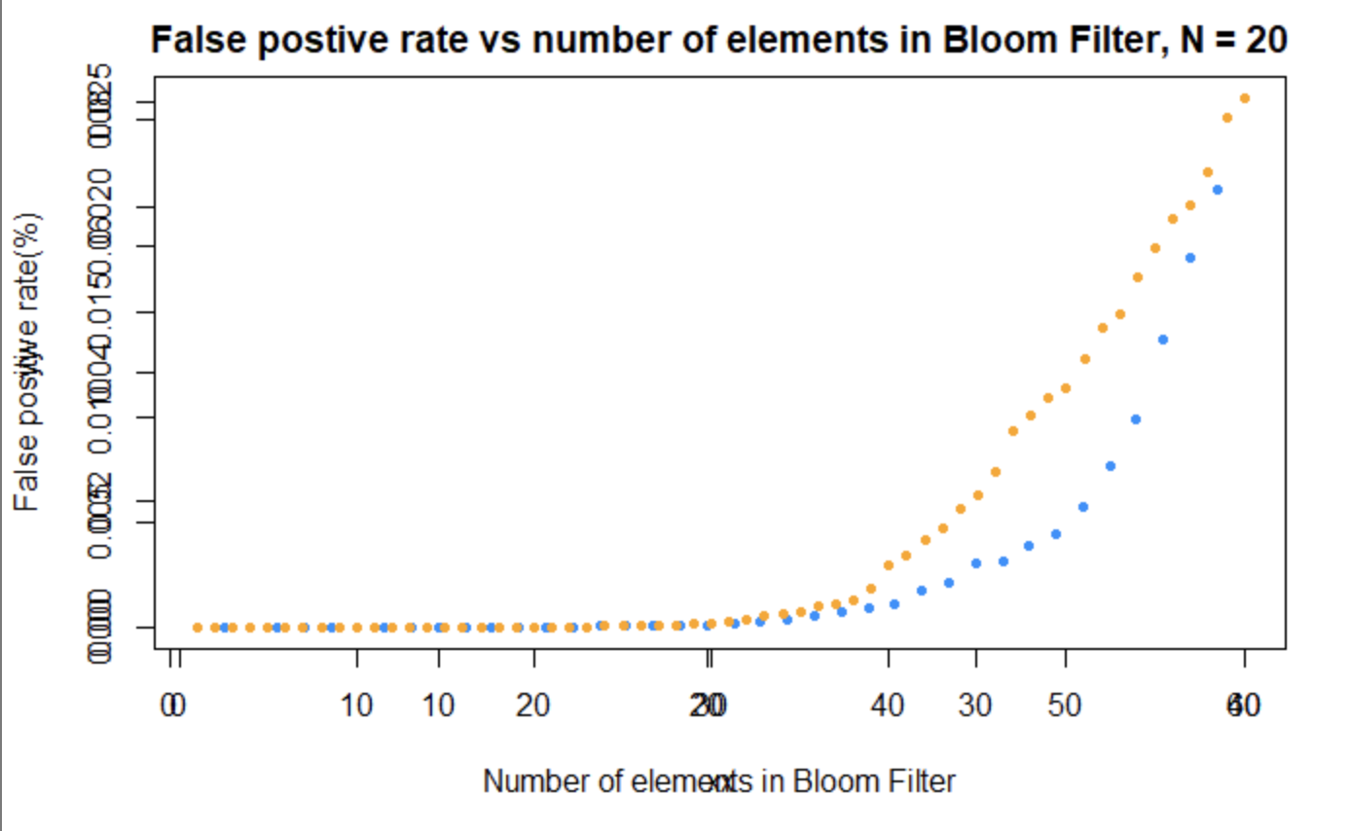
Evaluation, fairness.
When number of forwarders exceed preallocated one, the false positive rate of Bloom Filter would start to increase. This would have implications on fairness of profit distribution.

Slide 15
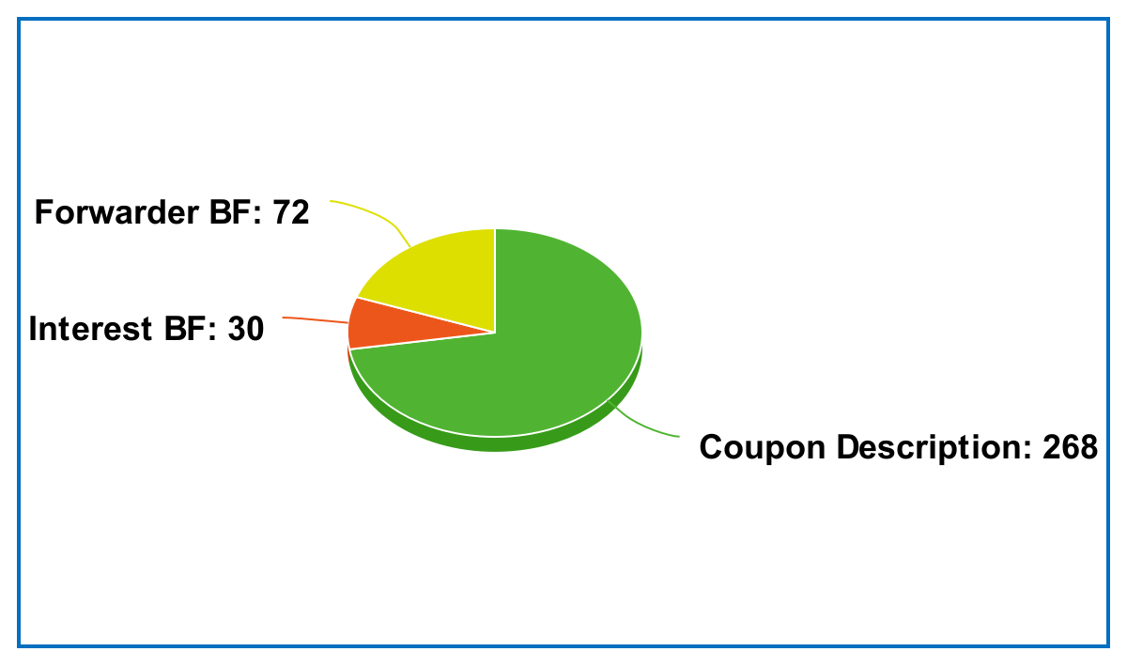
Evaluation - Implementation Based
(1) User A broadcasts a Bloom filter (BF) containing her interest information (Interest Bloom Filter) to see if other users have interests which overlap with his/hers;
(2) If User B’s interests overlap with User A's interests, User B broadcasts her related coupons with their Bloom filters containing forwarder information (Forwarder Bloom Filter)
Unit: Byte. Size of a coupon is 340 bytes.
Each phone can successfully receive related coupons from other phones which have overlapped interests within 30 meters.

Slide 16
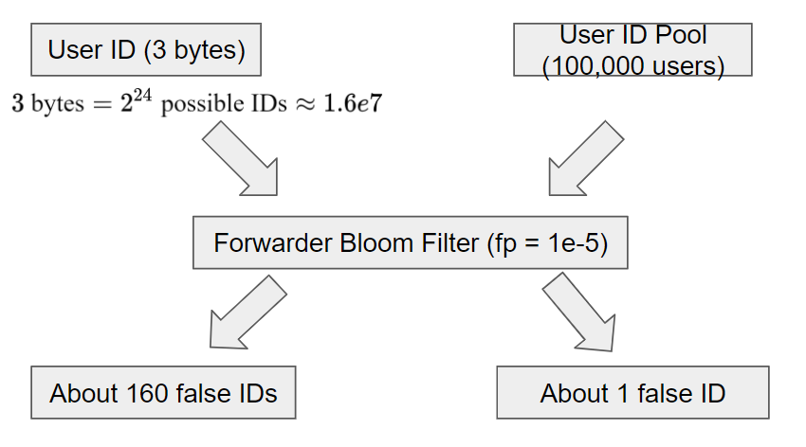
Discussion
1. Privacy preserving analysis
2. Improvements:
Generate areas of interest automatically
Refine ownership assignment methods when N > 20.
Notes:
The forwarder bf can achieve a certain extent to privacy preserving:
Even if someone managed to get to forwarder bf in the coupon, he/she cannot know who exactly has forwarded the coupon
Following scenario:
Am attacker hijacks a coupon with 20 user forwarded
he/she tries to get the forwarder list from the forwarder bf.
But the forwarder bf has false positive rate: lets say 1e-5 in this case
The attacker needs to check all possible user IDs
(in this example, user ID length is 3 bytes = 2^24 possible IDs)
Abont 160 false IDs are given by bf (some IDs that actually has not forwarded the coupon)
he/she cannot tell which 20 IDs are the actual forwarder
But the server can know the 20 IDs since the actual user pool size is smaller than 2^24 (in this case, say 10^5)
Then about only 1 false positive ID is given by the bf
Discuss about imporements

Slide 17
Conclusion
B²-Coupon is an efficient and non-intrusive mobile coupon distribution system.
B²-Coupon filters out unwanted targets so that users only receive the coupons which are related to their interests utilizing the Dual Bloom Filter.
The first Bloom filter automatically matches users with overlapped interests
The second Bloom filter records forwarder information and distributes coupon rewards in a space-efficient and fair manner.
B²-Coupon uses Bluetooth Low Energy beacons to avoid manual connection.
We have conducted large-scale simulation and implementation-based evaluation. Evaluation results show the promise of B²-Coupon for efficient, fair, and non-intrusive coupon distributions.

Slide 18
THANK YOU

